Slide 1

Unleash Your Swing Potential
Team Status Report I - Kickoff Meeting
Team Osmium
November 4, 2023
©Team Osmium

Slide 2


AGENDA
Team Contract & SLAs
Team Roles and Schedule
Project Selection Matrix / Weighted Scoring Model
Project Charter
Work Breakdown Structure (WBS) - Graphical view
Interim Project Scope Baseline in MS Project
Interim Project Schedule Baseline in MS Project
Project Cost Estimate and Basis of Estimates (BOE)
Time-Phased Budget and Performance Measurement Baseline (S-Curve)
Project Risk Register with Pre- and Post Mitigation Strategies
©Team Osmium

Slide 3


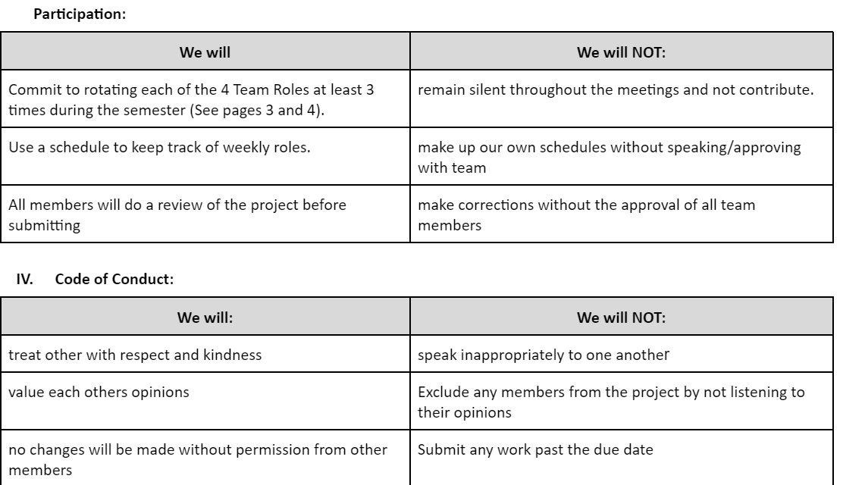
PARTICIPATION & CODE OF CONDUCT
©Team Osmium

Slide 4
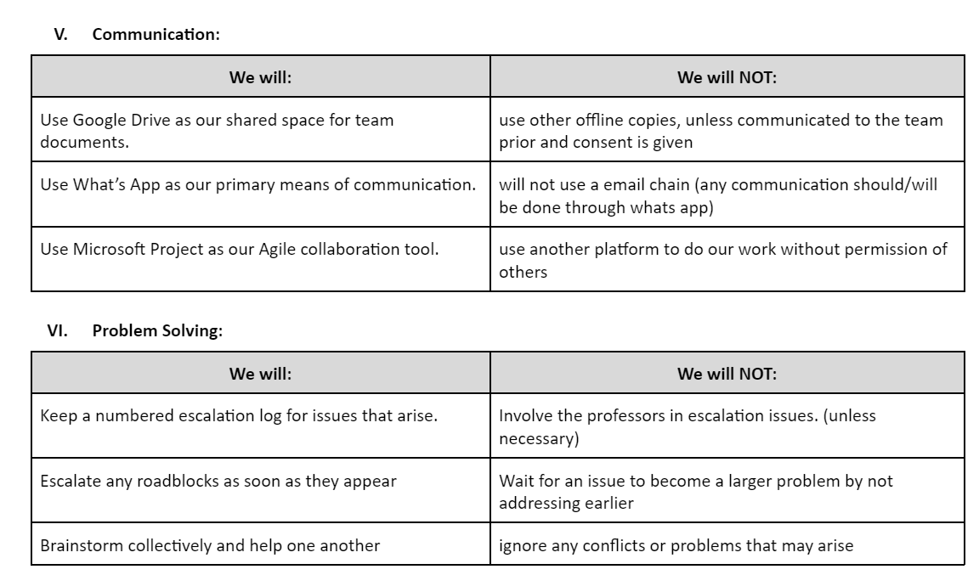
COMMUNICATION & PROBLEM SOLVING
©Team Osmium

Slide 5
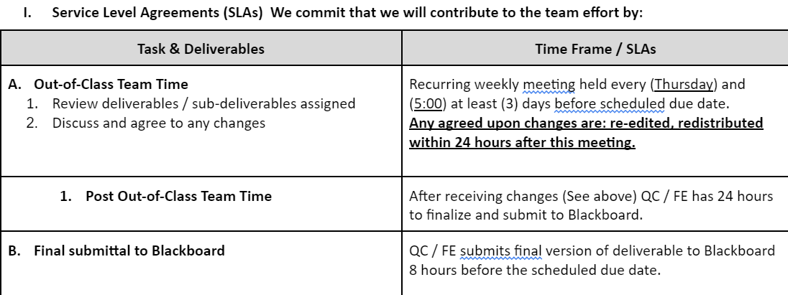
SERVICE LEVEL AGREEMENT
©Team Osmium

Slide 6
TEAM ROLES & SCHEDULE
Servant Leader | Ensures deliverables are broken into sub deliverables and assigned. Follows up to ensure deadlines are being met. Assists and removes impediments as needed. Co-presents with Final Editor (FE).
Researcher - Schwalbe and Examples / Templates ( RS )** | Acts as subject matter expert (SME) for the assignment. reads the textbook, does research and recommends format / approach. Assists content developer with creation of deliverables and sub-deliverables.
Content Developer I ( CD )** 1-4 | Takes responsibility for getting the deliverables / sub-deliverables completed and ready on a timely basis. Turns over the deliverables / sub deliverable to the Final Editor on a timely basis.
Final Editor | Reviews the completed deliverable for accuracy, consistency, and satisfactory fulfillment of the homework assignment. Sends incomplete work back to the Content Developer as necessary. Submits final deliverable via Blackboard 3 hours ahead of scheduled class. Co-presents with Servant Leader.
©Team Osmium
Notes:
SERVANT LEADER As the servant leader for team Osimum involves breaking our project deliverables into sub-deliverables, assigning tasks to the team, and closely monitoring deadlines to ensure that we meet our weekly goals. The servant leader actively assists in removing impediments that hinder team progress concerning our video tutorial
RESEARCHERS across all fields play a critical role in supporting the content developer by providing valuable insights and assisting in the creation of deliverables and sub-deliverables, ensuring that the project is informed only by reliable research and expert knowledge.
CONTENT DELVOPER significantly contributes to the success of the swing tutorial video by managing and delivering essential project components on time, ultimately leading to the creation of a high-quality instructional video.
FINAL EDITIOR - The Final Editor reviews and ensures the quality of the Swing of it deliverables, sends incomplete work for revisions, and submits the final materials three hours before class. They also co-present project updates with the Servant Leader.

Slide 7
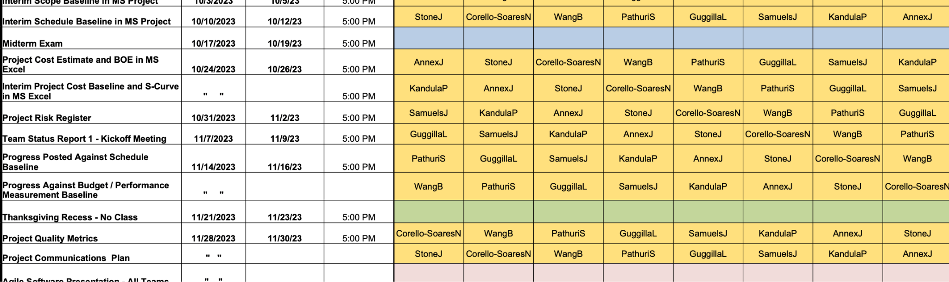
TEAM ROLES & SCHEDULE
Roles are constantly rotating
Meetings are now held at 8:00 AM on Friday’s
©Team Osmium
Notes:
Its also important to note that roles are constantly changing weekly and we hold a meeting every Firday at 9 am as new members have joined our group

Slide 8
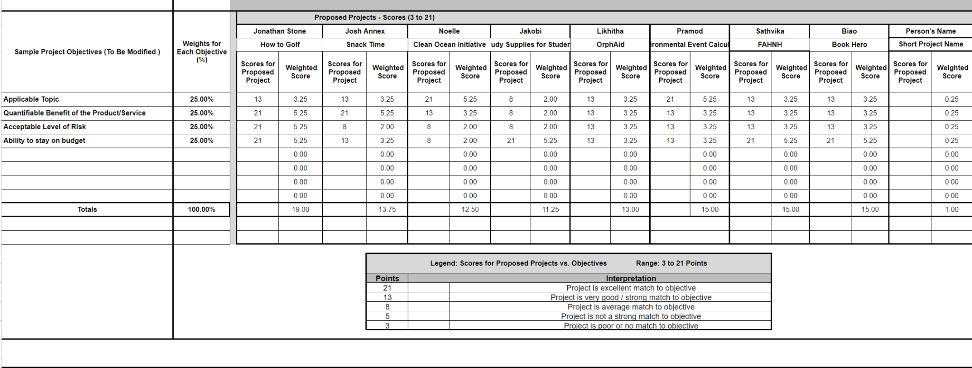
PROJECT SELECTION MATRIX/
WEIGHTED SCORING MODEL
©Team Osmium

Slide 9
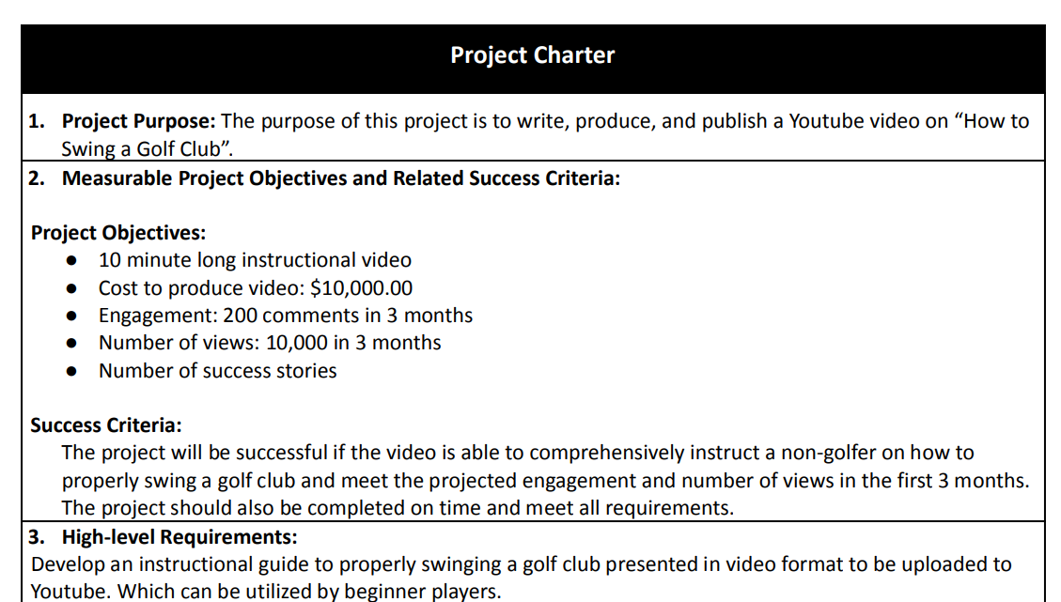
PROJECT CHARTER
©Team Osmium
Notes:
Instruct someone on the proper form to play golf
10k views in 3 months

Slide 10
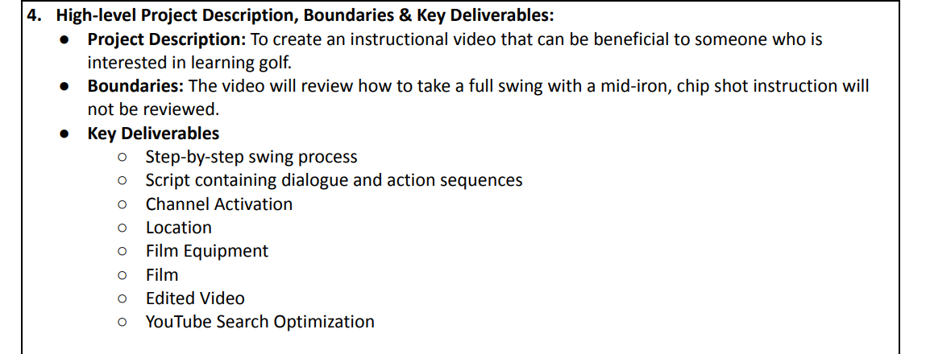
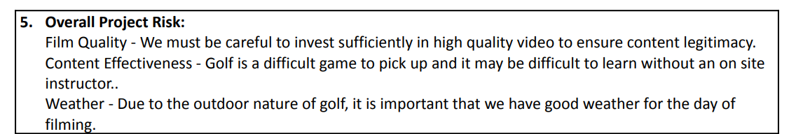
PROJECT CHARTER
Only long game
Risks mitigated
©Team Osmium
Notes:
Instructional video beneficial for someone on golf. It will NOT discuss shortgame

Slide 11
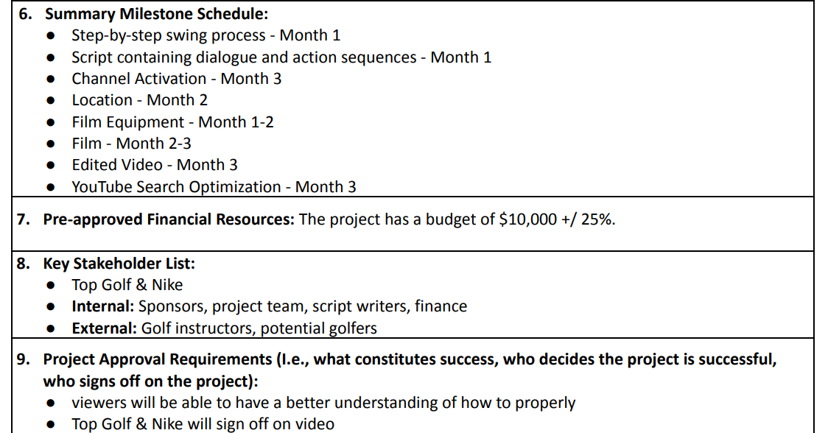
PROJECT CHARTER
Timeline shortened
Budget Updated
Nike didn’t respond
©Team Osmium

Slide 12
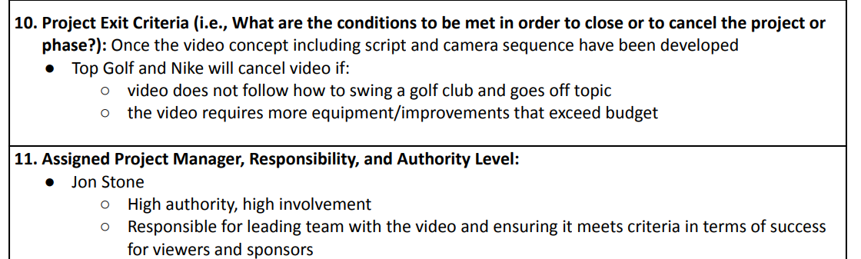
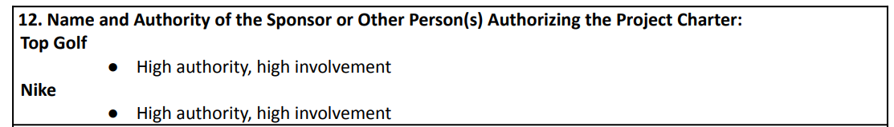
PROJECT CHARTER
Updated
©Team Osmium

Slide 13
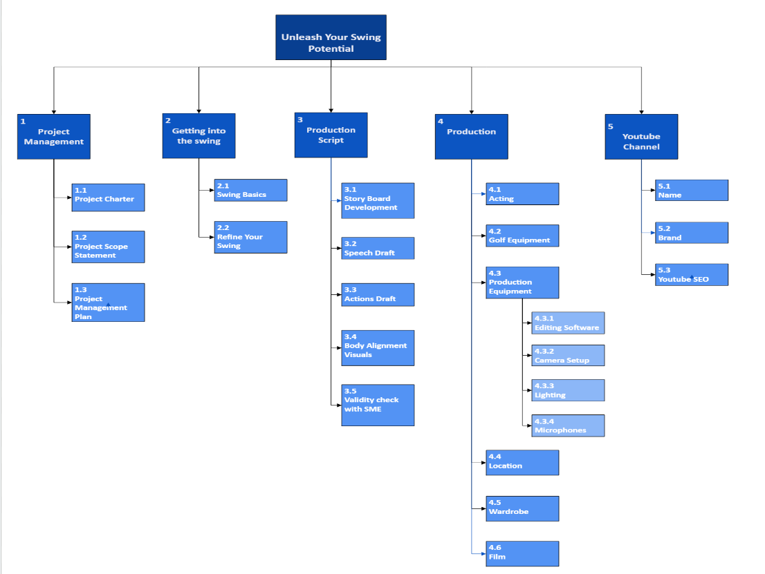
GRAPHICAL WORK BREAKDOWN STRUCTURE
©Team Osmium

Slide 14
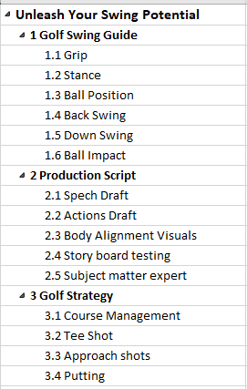
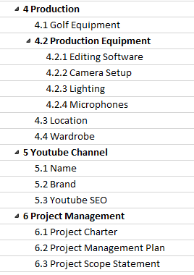
PROJECT SCOPE BASELINE
©Team Osmium

Slide 15
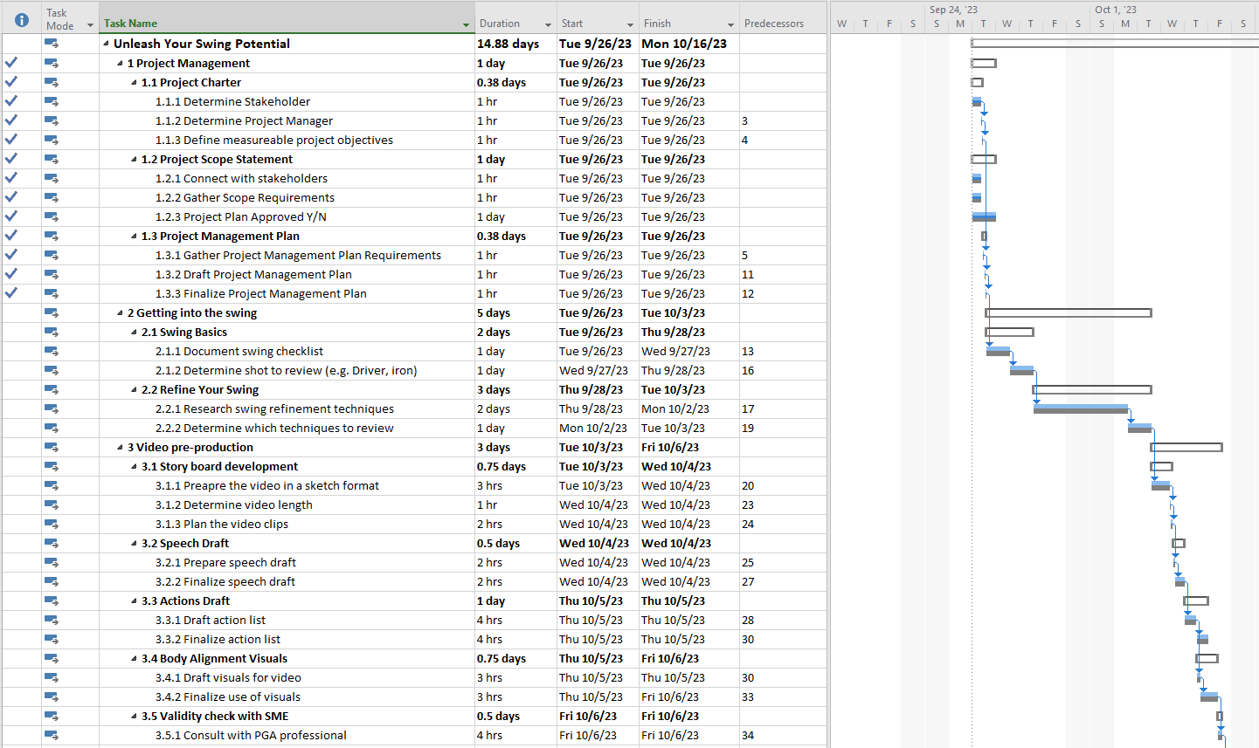
PROJECT SCHEDULE BASELINE
©Team Osmium

Slide 16
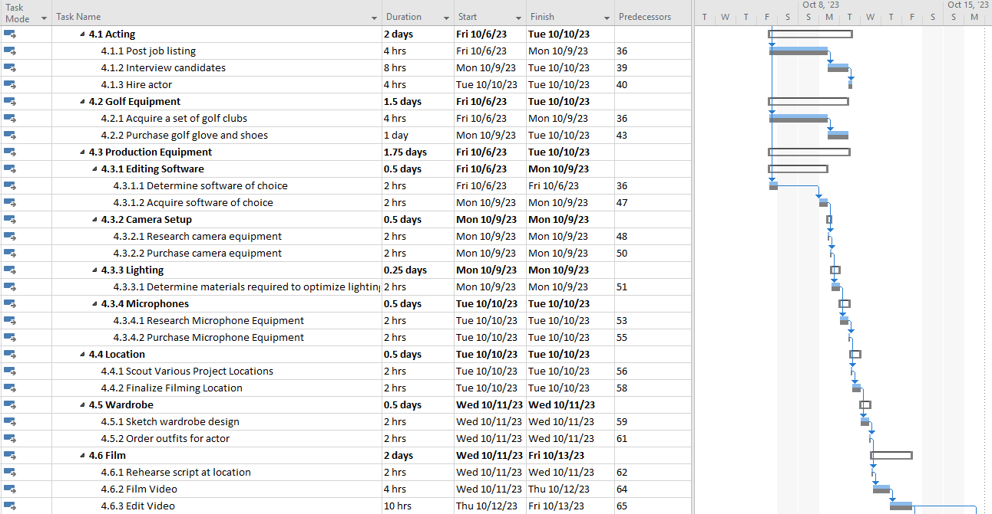
PROJECT SCHEDULE BASELINE
©Team Osmium

Slide 17
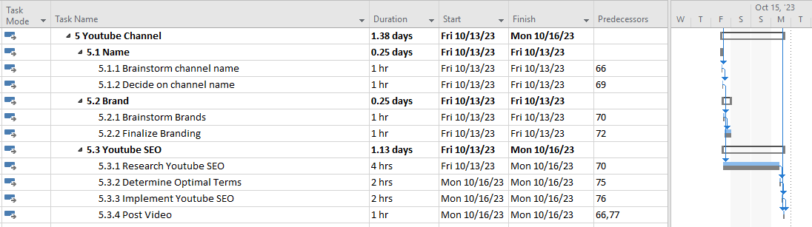
PROJECT SCHEDULE BASELINE
©Team Osmium

Slide 18
COST ESTIMATE
Assume golf clubs, attire, other props, renting course space are included in non-technical production
Assume we are going to rent the camera, lighting, and editing equipment
Assume 2 days of course rental due to weather conditions
Assume 2 team dinners at the beginning and end of the project (non-labor expenses)
Labor assumptions are based off average salary for particular roles
Assume multiple people to work on a particular activity (instead of 1 person for 1 week multiple people in 1 day)
©Team Osmium

Slide 19
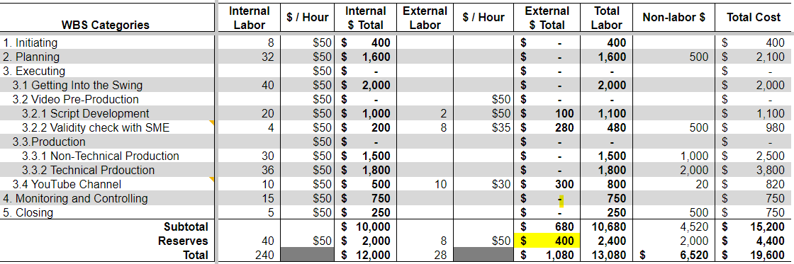
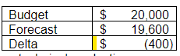
COST ESTIMATE
©Team Osmium

Slide 20
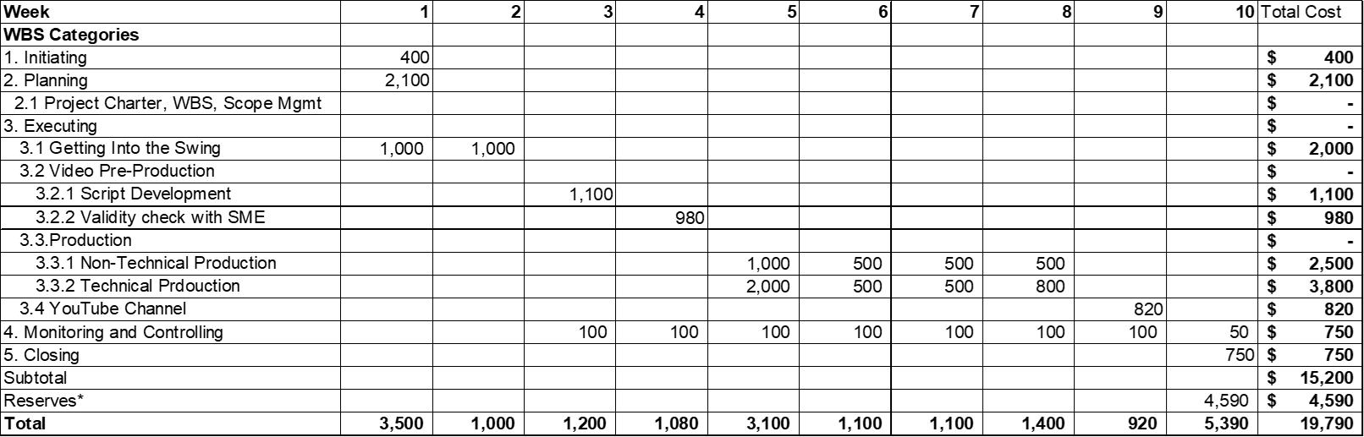
TIME PHASED BUDGET
©Team Osmium

Slide 21
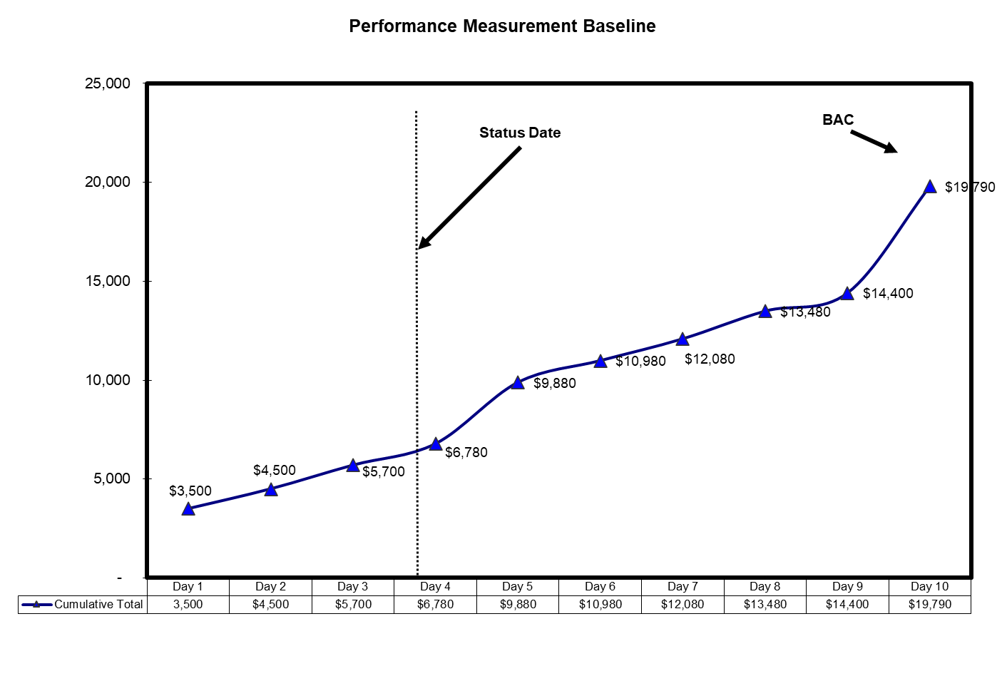
PERFORMANCE MEASUREMENT BASELINE
©Team Osmium

Slide 22
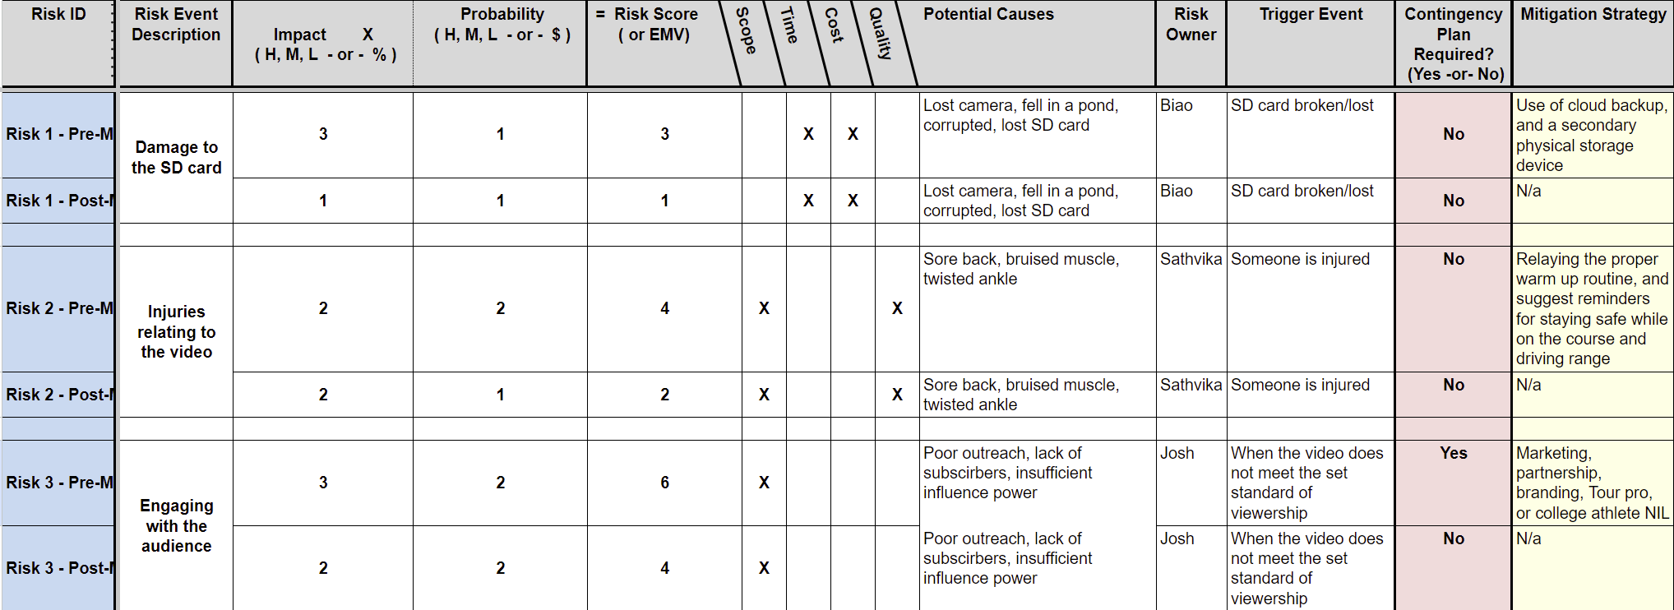
RISK REGISTER
©Team Osmium

